Slide 1
CMPS451 Project Report
DK Crew: Zachary Gros, Stephen Legnon

Slide 2
Background on EEG Signals
Before beginning working on the project, we were required to research EEG signals and how they were generated. These next few slides will show our findings on the generation and recording of EEG signals.

Slide 3
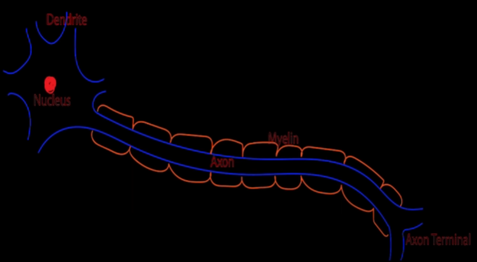
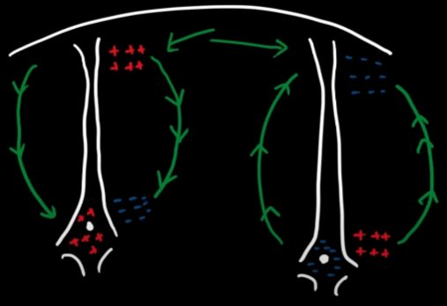
Generation of EEG Signals
Electroencephalography (EEG) signals are generated from the electrical activity of cortical pyramidal neurons within the brain’s cerebral cortex (the brain’s outermost layer). The detectable activity is the electrical signals emitted by the communication of two neurons. The sending neuron emits either an excitatory (+) or inhibitory (-) signal to the receiving neuron which then copies the signal’s charge. Then, the extracellular space around the neuron builds up an opposing charge around the receiving neuron’s nucleus. Additionally, the extracellular space near the axon terminal of the receiving neuron builds up a charge of the same charge as the neuron. With opposing charges occurring along the neuron, current will then begin to flow between the two ends of the neuron.

Slide 4
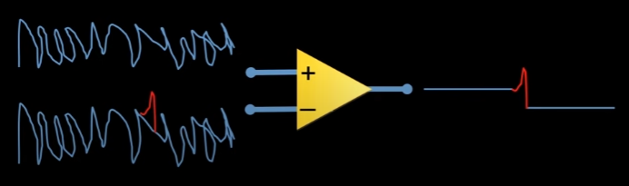
How EEG Signals are Recorded
As stated in the previous slide, the neurons that make up the neuron groups responsible for generating EEG signals are located in the third and fifth layers of the brain’s cerebral cortex. Given that the cerebral cortex is the outermost layer of the brain, the generated EEG signals can be recorded by placing electrode along the scalp of a patient in which these electrodes record EEG signals using a differential amplifier. The differential amplifier detects two electrical inputs from two neurons and outputs the difference between the two inputs. This technology is very useful for recording and displaying miniscule differences in electrical signals.

Slide 5
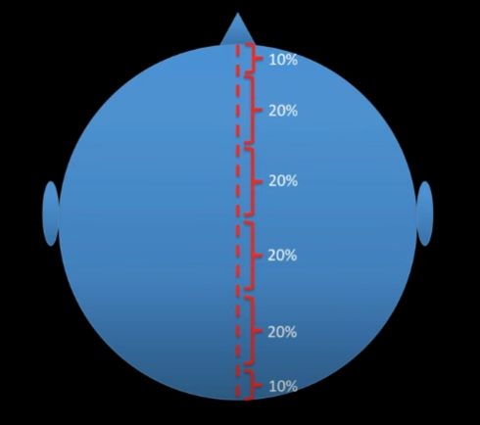
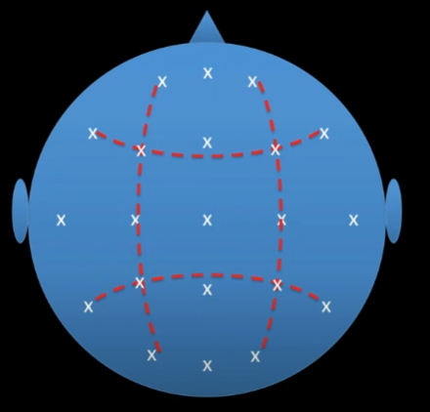
Standard Electrode Placement Scheme for Recording EEG Signals
The standard electrode placement scheme for recording EEG signals is first constructed by placing electrodes in 10-20% increments beginning from the nasion located at the bridge of the nose to the inion located at the back of the head as shown in the leftmost diagram. This is repeated perpendicular to the original line. Then, electrodes are placed along the circumference of the head in 10% increments with electrodes being placed along the intersections of the parasagittal lines running across the head as shown in the diagram to the right.

Slide 6
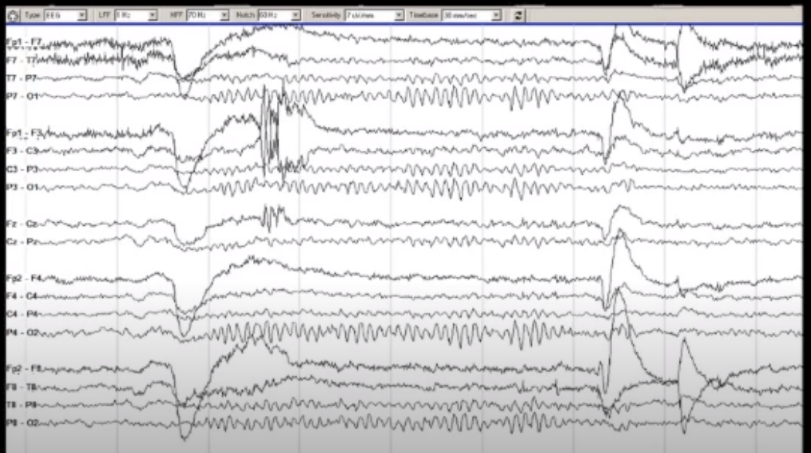
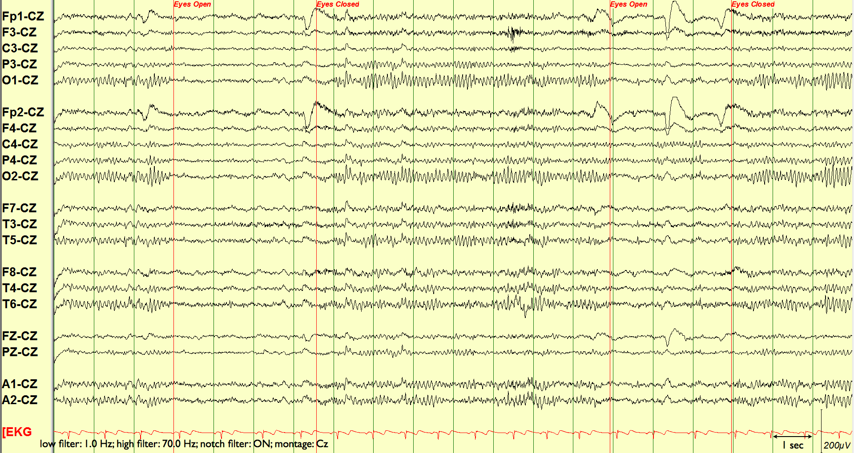
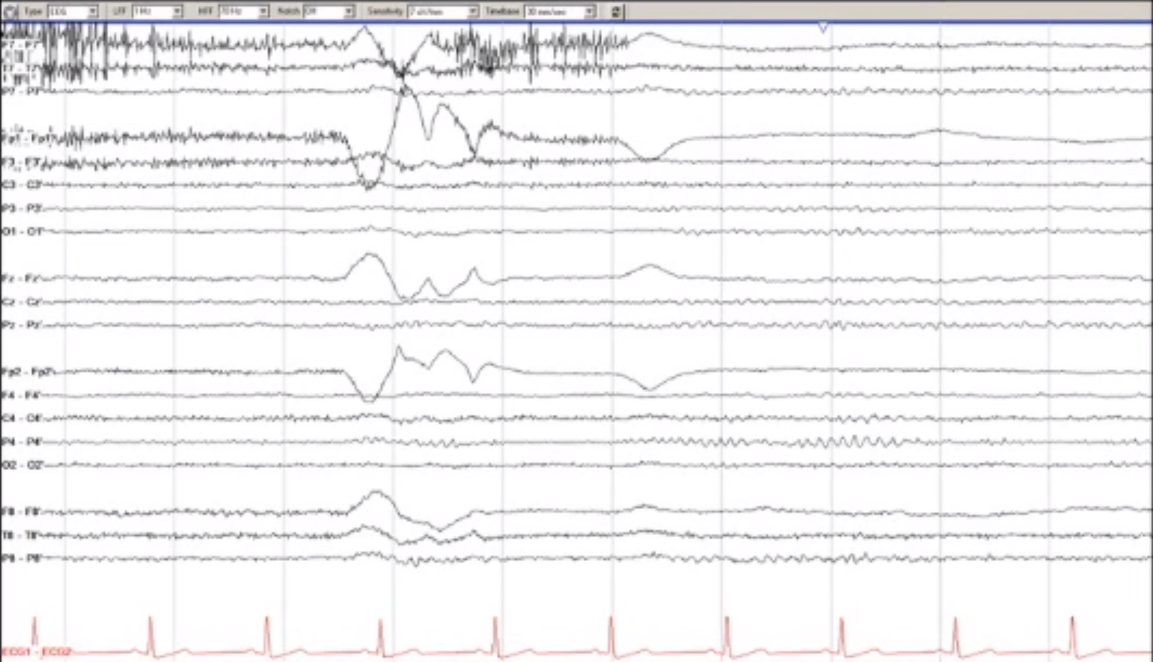
Montage Schemes
Bipolar Montage
EEG montages are different ways to visualize EEG recordings. They involve capturing the differences between signals from various electrodes and comparing these signals on a graph. Some different types of montages are bipolar, reference, and laplacian montages. Bipolar montages compare the signals of adjacent electrodes along a specified path from the front to the back of the head, creating a chain of signals. These chains are recorded across multiple pathways and displayed collectively on a chart. Reference montages, on the other hand, involve comparing individual electrodes or groups of electrodes to a single reference electrode or a chain of electrodes. Laplacian montages focus on comparing a specific electrode’s signal to the average of its nearest neighboring electrodes.
Reference Montage
Laplacian Montage

Slide 7
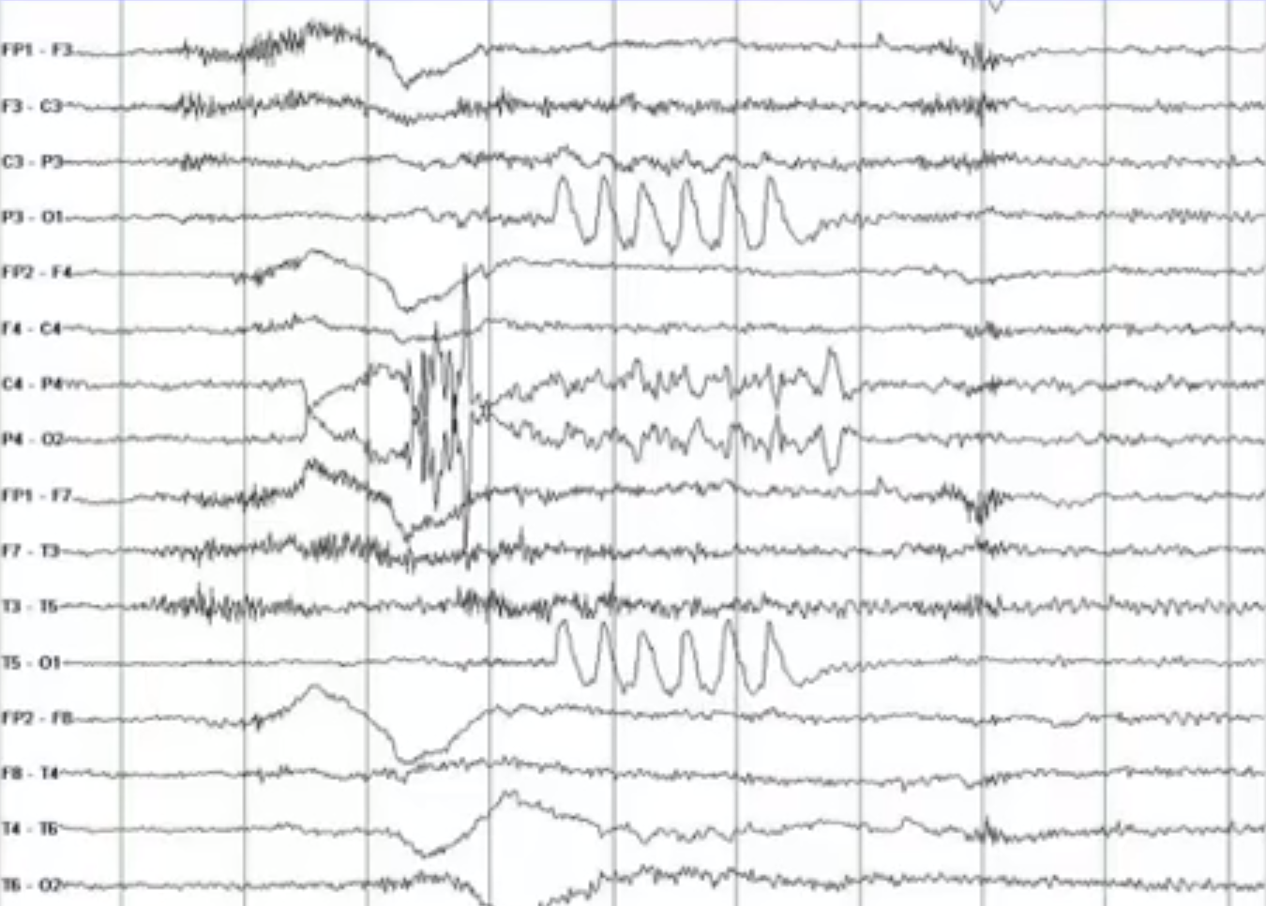
Generation of the eyes-movement artifact
The eye can be thought of as having a positive and a negative end. When the eye moves toward a particular electrode on the scalp, it generates a spike of positive electricity, leading to an artifact in the EEG output. For example, during Bell’s phenomenon, when a person blinks, the eye automatically moves upward, creating a change in positive charge at the electrodes near the front of the eye. This upward movement can be particularly pronounced in electrodes located above the eye. As a result, there is a larger negative reading in the surrounding electrodes due to the increased positive charge at the targeted electrode, which can complicate the interpretation of the EEG data.
EEG with eye movement artifact

Slide 8
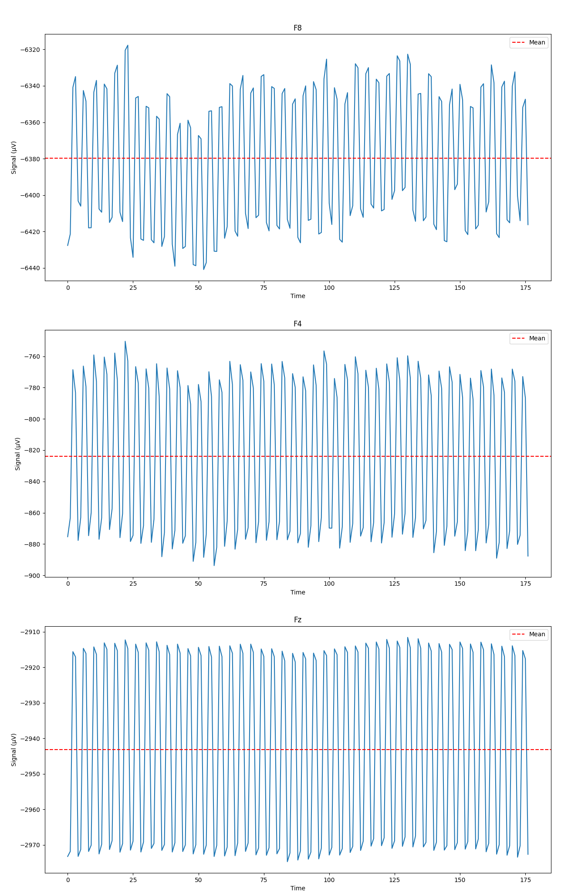
Reading and Visualizing EEG Data
With our research into EEG concluded, we were tasked to read and visualize the EEG streams from 3 different channels, ‘F8’, ‘F4’, and ‘Fz’, the graphs of which can be seen to the right. The sampling rate is around 1000 Hz, and there were 177 total recorded signals in each channel. Looking at the graphs of the channels, we can see a very subtle pattern in the shape of the graph. The pattern is more visible on ‘F8’ and ‘F4’ while the pattern on ‘Fz’ is very subtle.

Slide 9
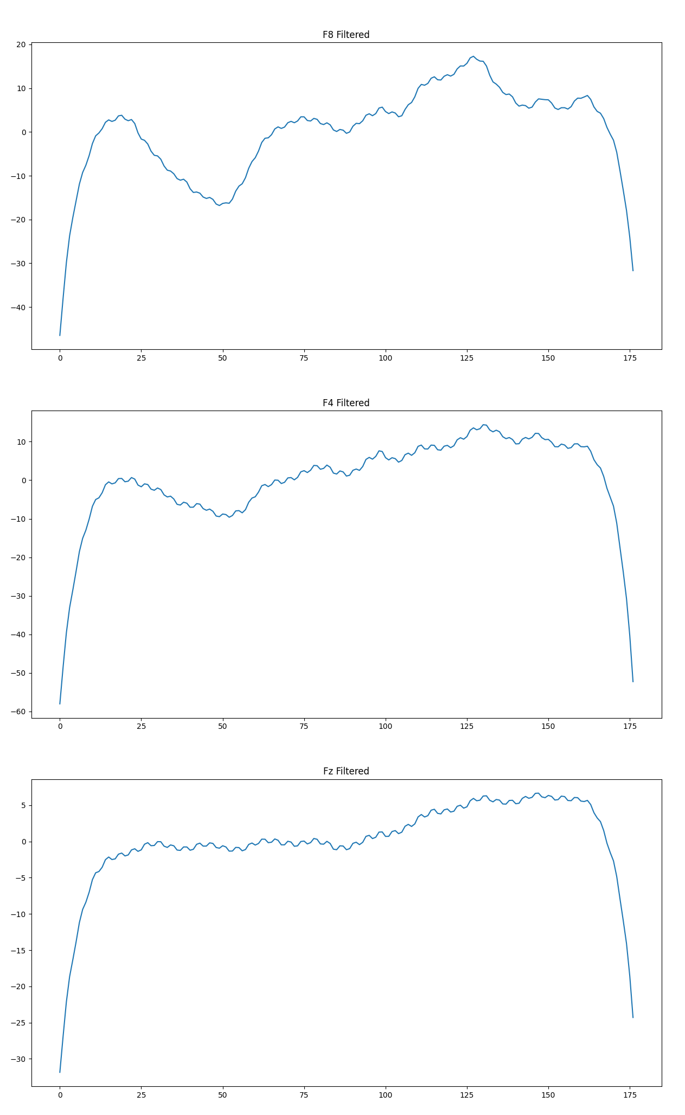
Filtering the Signals
In order to make the data more readable and usable, we decided to filter it to remove any noise. The filters we applied, in order, were a Notch filter of [60, 120, 180, 240], an Impedance filter of 125±1, and a Band-pass filter of [0.5, 32]. After applying the filters—a graph of the filtered data can be seen to the right—we were able to more clearly see the patterns in the signal data we mentioned on the previous slide.

Slide 10
Windowing the Data
For our next task, we were given a zip file, DataSmall.zip, to extract data from to generate features. In order to generate the desired features from DataSmall.zip, we must window the streams from each file and calculate the mean and standard deviation of the windows for each channel. To do so, we must iterate through each file in each of the 4 folders and window all three required channels (F8, F4, Fz).

Slide 11
Feature Generation
Once the mean and standard deviation for each window is calculated, we can use these values to calculate the features for each channel. We used the numpy library for calculating the mean and standard deviation, and we used the scipy library to calculated skewedness and kurtosis. Once each of these features are calculated, we add them to a new row in a pandas DataFrame containing the generated features for each of the 3 channels in all of the files in DataSmall.zip. Each subject folder, ‘sb1’ and ‘sb2’, were processed separately as TrainingValidateData and TestData dataframes, respectively. These dataframes were sent to separate csv files using the built-in to_csv function in pandas.

Slide 12
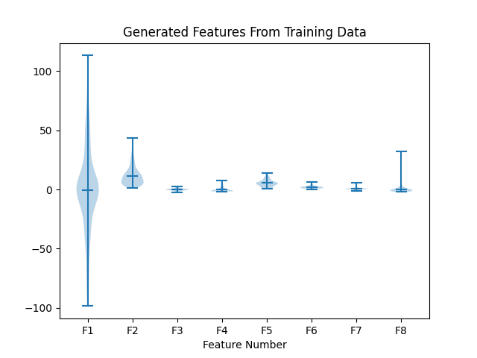
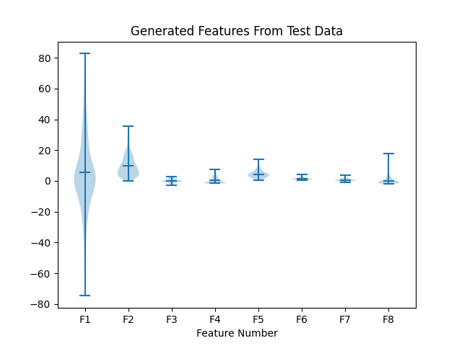
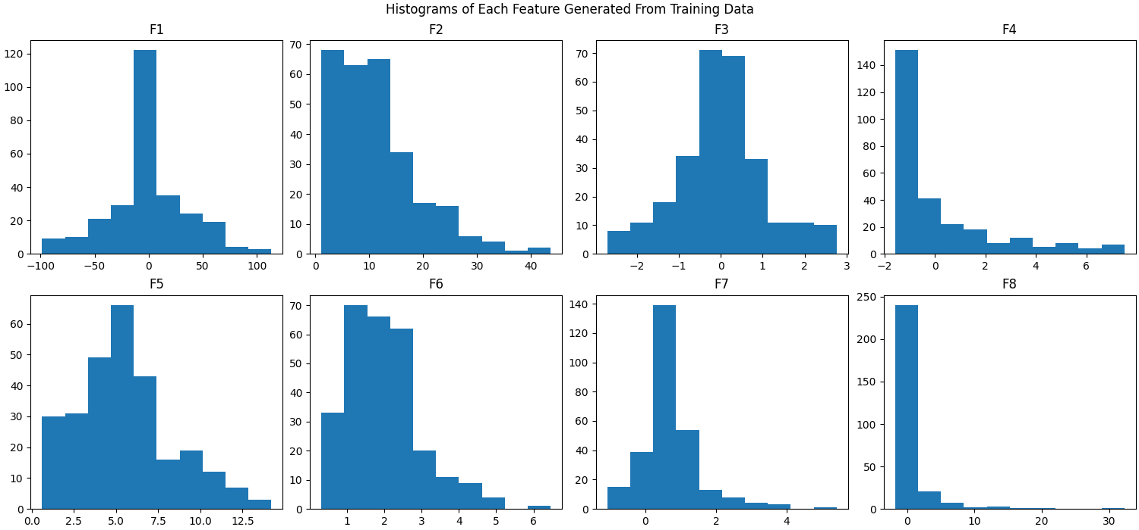
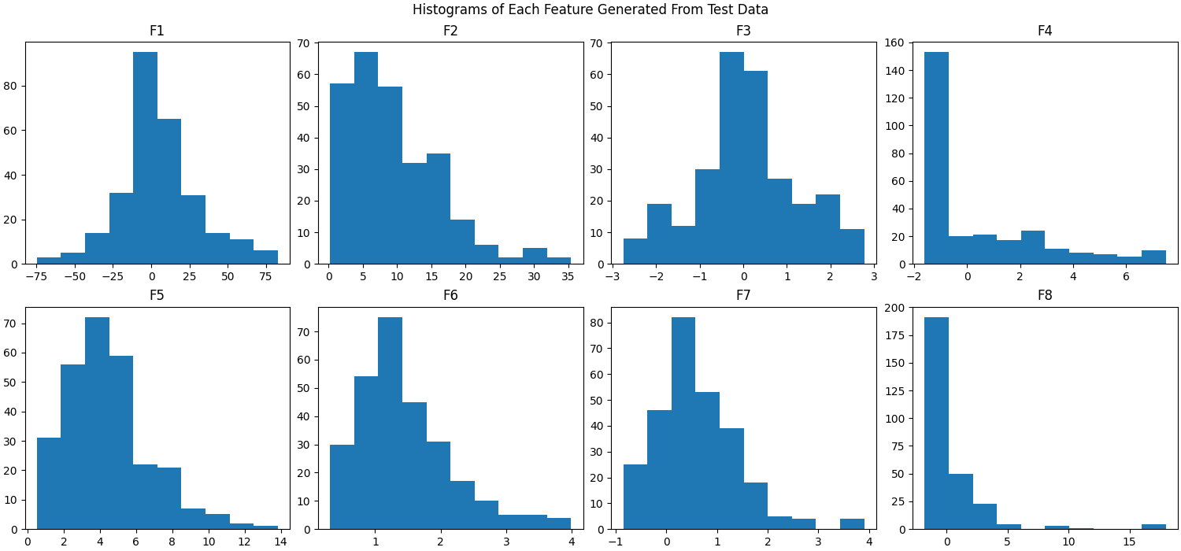
Graphing Features
Upon the completion of generation the features for the final file in DataSmall.zip, we plotted the features together on a violin plot and separately on histograms in order to properly show the trends in the generated features. The training data and testing data were graphed separately. The graphs can be seen below.

Slide 13
Analysis of Feature Plots
Looking at the plots on the previous slide, we can see that F1 (the mean of the window means) is a lot more spread out than the rest of the features in the dataset, making it hard to visually see trends in the other 7 features. By plotting them in individual histograms, however, we can clearly see the trends of each individual feature. For instance, F1 and F3 look to be distributed mostly in the center of the data while the other 6 featured have a negative skewness of varying degrees. Furthermore, F3, F4, F5, F6, and F7 appear to fall within a much smaller range than F2 and F8 which both have a significantly smaller range than F1.
Additionally, be comparing the graphs from the training data to the graphs of the testing data, we can see that the data is overall similar, but the range of the values differ with the overall shape being the same.

Slide 14
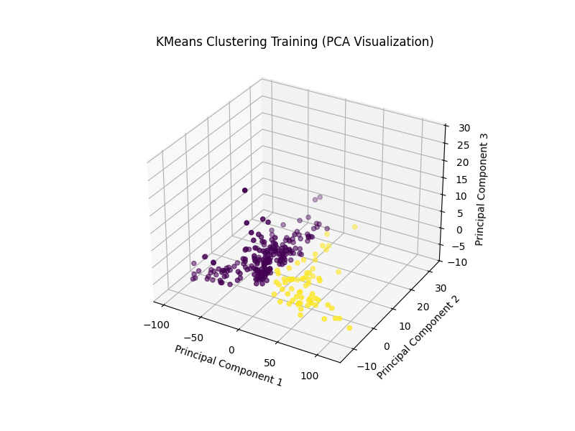
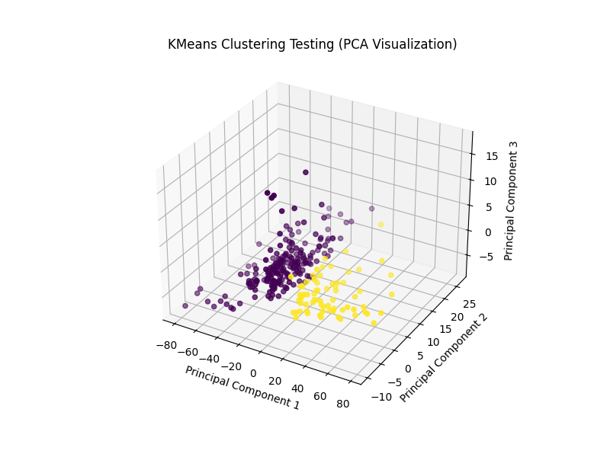
Data Clustering Using K Means
Our final task was to cluster the data from the generated features into two clusters. To start with, we used n=2 K Means for K Mean clustering. We decided to use Principal Component Analysis to more easily visualize and cluster the data while still taking into account all of the features in the dataset. The target value for each cluster was the session each datapoint was generated from (‘se1’, ‘se2’). The yellow points represent ‘se1’ and ‘se2’ is represented by the purple points. Looking at the graphs—shown to the right—we can see that the training data is more sparce that the testing data, but the training data is more dense in the global center than the training data is.

Slide 15
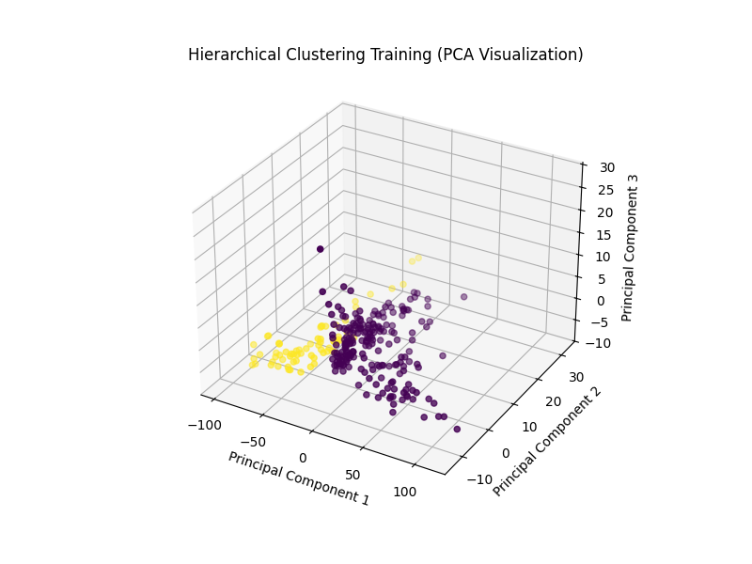
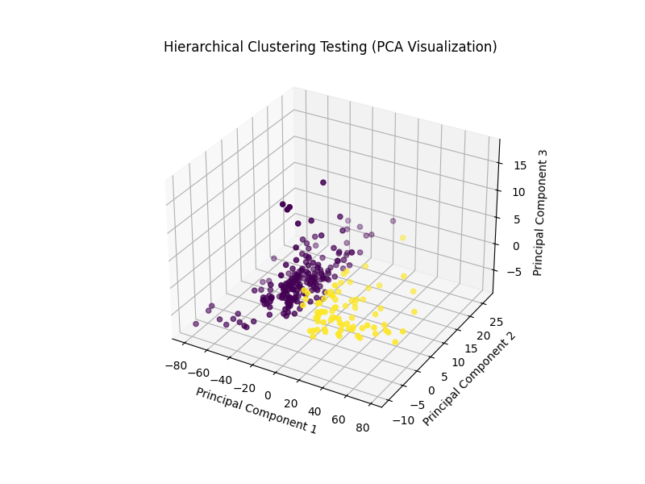
Data Clustering Using Hierarchical Clustering
Along with K Mean clustering, we were asked to cluster the data using Hierarchical clustering. The graphed clusters can be seen to the right. The yellow points represent ‘se1’ and ‘se2’ is represented by the purple points. Interestingly, the clusters for the training data appear to have switched sides entirely while the testing data seems to have stayed consistent with the K Mean clusters on the previous slide. Looking at all four graphs, a clear divide can be seen between the two clusters with not much overlap between them.

Slide 16
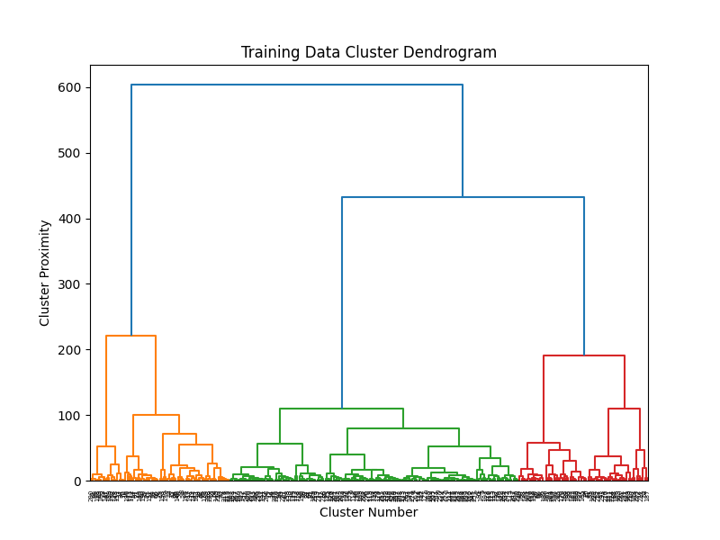
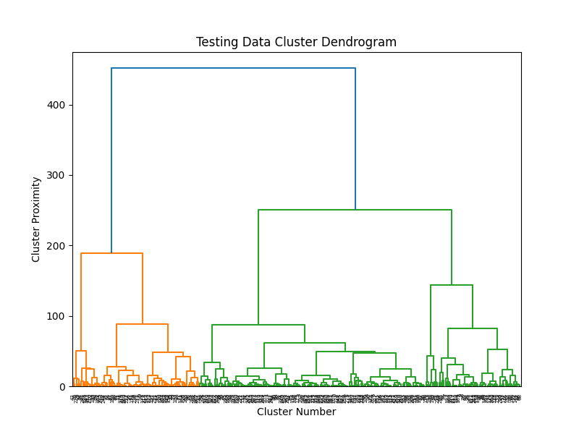
Cluster Dendrograms
Interestingly, when the training data is visualized onto a dendrogram using hierarchical clustering, we can see that the data is separated into three clusters initially while the testing begins with two. This makes sense since we established that the training data was more sparce that the testing data. Additionally, this may explain why the clusters from the training data on the graph on the previous slide appear to have swapped positions. Orange represents ‘se1’ and green represents ‘se2’.

Slide 17
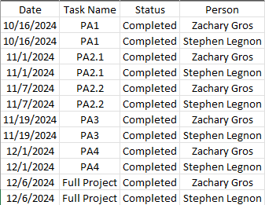
Task Completion Report

